Slide 1
Research Proposal Workshop
John C. Greene Society & Research Team at SOD
2025
Slides courtesy of Anny Yang
Notes:
Adapted by Anny Yang

Slide 2
Why participate in research here at UCSF?
Develop critical thinking skills
Gain invaluable research experience
Better understand the connection between research and clinical practice
Work on a research project across 32 weeks
Present your poster at Research and Clinical Excellence Day and other conferences including the AADOCR and/or IADR
$1,500 in stipend and up to $1,000 for research expenses

Slide 3
What to expect?
Total Commitment: July 2025 – March 2026
400hrs total, spread over 32 weeks (average 12.5h/wk but ranging from 8h to 20h/wk)
Attend monthly update meetings and workshops
Complete progress reports (x3)
Have IRB (if applicable) completed by mid-Aug 2025
Deadline to submit proposal: May 1 2025
Email pdf file to roger.mraz@ucsf.edu

Slide 4
What to expect?
Fellows announced June 2nd, 2025
Quarterly update meetings
August 2026: Abstract writing workshop, poster workshop with Dr. Berens
October 2026: RCED presentation
March 2027: AADOCR
Great opportunity to network with residencies, meet other dental researchers, many competitions and awards (great for CV!!)

Slide 5
Breakdown of the Research Proposal
I. Cover page
Title
Your name and email
Your mentor’s name and email
Date of submission
II. Research Proposal (Limit to 4 pages PDF, 1400 words!!)
Specific Aims
Research Strategy
Significance
Innovation
Approach
Additional Information:
Resource Information and Facility/Equipment
Other Support for applicant/sponsor (if any)
Recombinant or DNA Molecules (if any)
III. Literature Cited
IV. Letter of support from your PI

Slide 6
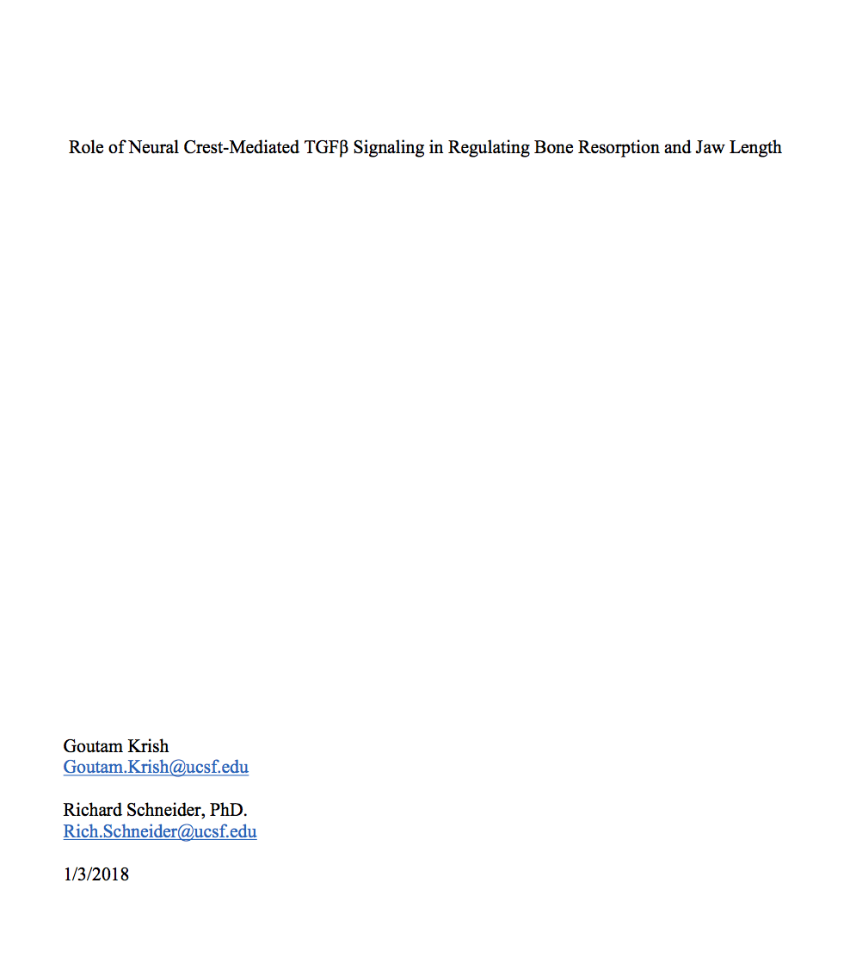
I. Cover Page
Title: Provides a specific summary of the proposed work, without too much detail
Your name and email
Your PI’s name and email
Date of submission

Slide 7
II. Research Proposal: Specific Aims
Specific Aims
Research Strategy
Significance
Innovation
Approach
Additional Information:
Resource Information and Facility/Equipment
Other Support for applicant/sponsor (if any)
Recombinant or DNA Molecules (if any)

Slide 8
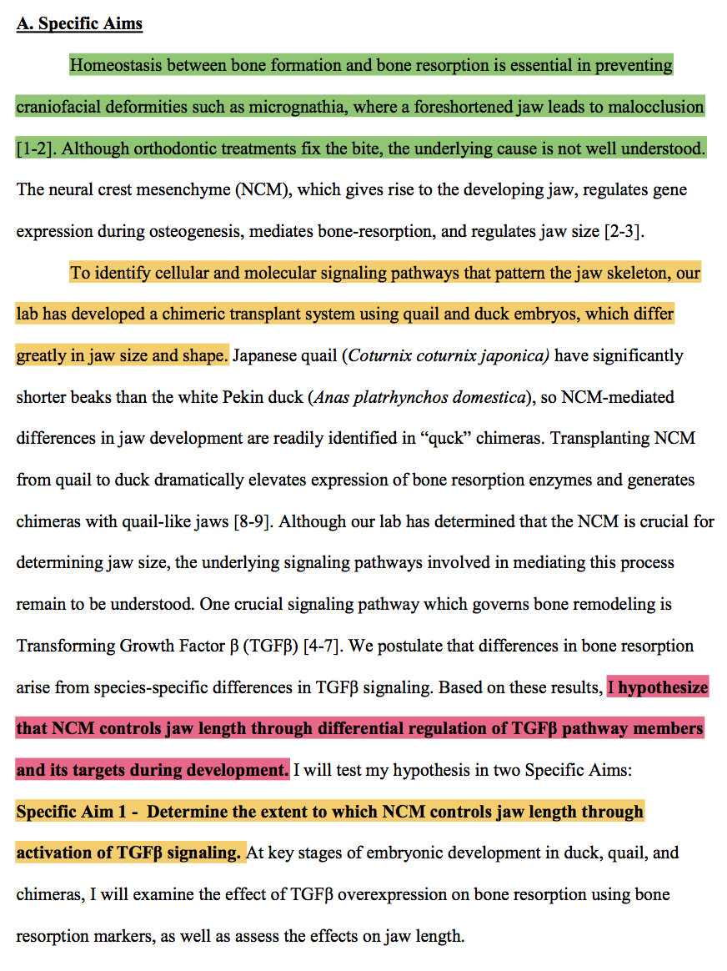
Specific Aims
There are 3 essential components of a good research proposal:
Why should they fund your research?
Novelty
Clinical Significance
Contribution to the society
What are you going to do?
Your research hypothesis
Overarching goal of the project
How are you going to do it?
Specific Aims/Methods

Slide 9
Specific Aims
The hardest part of writing a research proposal
Concise
Every single word counts!
Precise
Background and methods need to be accurate
Interesting
Live and die by the specific aims
https://www.biosciencewriters.com/NIH-Grant-Applications-The-Anatomy-of-a-Specific-Aims-Page.aspx

Slide 10
Specific Aims: Example
Why: Homeostasis between bone formation and bone resorption is essential in preventing craniofacial deformities. Although orthodontic treatments fix the bite, the underlying cause is not well understood. Although our lab has determined that A is crucial for determining jaw size, the underlying signaling pathways involved in mediating this process remain to be understood
What: To identify cellular and molecular signaling pathways that pattern the jaw skeleton, our lab has developed a chimeric transplant system using quail and duck embryos, which differ greatly in jaw size and shape.
Central Hypothesis: I hypothesize that A controls jaw length through differential regulation of B during development.
How:
Specific Aim 1: Determine the extent to which A controls jaw length through activation of TGFB signaling
At key stages of embryonic development in duck, quail, and chimeras, I will examine the effect of B overexpression on bone resorption using bone resorption markers, as well as assess the effects on jaw length.
Specific Aim 2: Determine the extent to which A controls jaw length through inhibition of B.

Slide 11
II. Research Proposal: Significance
Specific Aims
Research Strategy
Significance
Innovation
Approach
Additional Information:
Resource Information and Facility/Equipment
Other Support for applicant/sponsor (if any)
Recombinant or DNA Molecules (if any)

Slide 12
Significance
Describe the broad problem that your research is trying to tackle
Show the reader the clinical importance of your research
Perform a literature review to determine:
What has been done
How your study will expand on current knowledge
You can use preliminary data from your lab to support your study

Slide 13
Significance: Example
Introduction of broad problem
Sample Text: In the United States, craniofacial malformations are one of the most common birth defects in humans.
Clinical Importance
An increased understanding of the mechanism behind these structural diseases would be useful for the development of preventative or therapeutic applications.
What has been done?
However, despite progress towards identifying the genetic basis of these diseases, there is a lack of genotype-phenotype correlation, even in those with identical mutations, that makes it difficult to understand the mechanism in individual patients.
How your study will expand the current line of thinking?
This study aims to elucidate the mechanisms that control these genetic diseases and provide insight to possible preventive treatments for patients.

Slide 14
II. Research Proposal: Innovation
Specific Aims
Research Strategy
Significance
Innovation
Approach
Additional Information:
Resource Information and Facility/Equipment
Other Support for applicant/sponsor (if any)
Recombinant or DNA Molecules (if any)

Slide 15
Innovation
Describe what new information your research will contribute to the field
If there are gaps in previous research that your study will fill, how will this expand on current project(s) being done?
If a novel (i.e. never been done/used before):
Method
Approach
Assay
Cell Type
Etc.
Is being utilized, this is where you would describe (or expand on) them

Slide 16
Innovation: Example
Sample Text: From the current literature we know many genetic and environmental causes of HPE and other craniofacial malformations but we do not understand why there is variation.
Introduction Broad problem
Clinical Importance
As stated above, the canonical Wnt pathway has a crucial role in craniofacial development.
However, to our knowledge, previous studies have yet to analyze the Wnt-signaling pathway and its correlation to a range of phenotypes in models within the same genotype.
What has been done?
How your study will expand current link of thinking?
Studying this pathway in a novel model of HPE that recapitulates the wide variation of craniofacial phenotypes will provide unique insight to disease variation that is currently present in human HPE.

Slide 17
II. Research Proposal: Approach
Specific Aims
Research Strategy
Significance
Innovation
Approach
Additional Information:
Resource Information and Facility/Equipment
Other Support for applicant/sponsor (if any)
Recombinant or DNA Molecules (if any)

Slide 18
Approach (Materials & Methods)
Sample Text: “Tissue samples from the mouse embryos will be processed for Western Blot and immunohistochemistry. Wnt signaling quantification will be visualized using Western blot for active β-catenin and/or immunohistochemistry for β-catenin nuclear staining. Additionally, the Wnt target gene Axin2 will be quantified in order to determine Wnt expression levels. After microCT scanning, the heads will be collected and total protein will be prepared. This will be run on an SDS-PAGE gel and transferred to a membrane for western blot analysis. Alternatively, heads will be embedded in paraffin, sectioned and stained with the antibodies to visualize the distribution of Wnt pathway activation. An estimate of the proportion of positive nuclei will be determined using Stereology.” Statistical significance will be determined using One-Way ANOVA and Two-Way ANOVA.
Describe each experiment to be used individually
Should be detailed enough that someone reading can replicate
Section should include how data will be analyzed
If using a known or widely used protocol/assay/method, make sure you add a reference or citation

Slide 19
II. Research Proposal: Additional Information
Specific Aims
Research Strategy
Significance
Innovation
Approach
Additional Information:
Resource Information and Facility/Equipment
Other Support for applicant/sponsor (if any)
Recombinant or DNA Molecules (if any)

Slide 20
Additional Information
Resources
With help from your lab or past proposals, give detailed information about your lab’s resources
Location (i.e. Which campus, size of laboratory, bench space, utility rooms, core facilities, animal facilities, etc.)
Equipment (i.e. Centrifuges, Computer Hardware/Software, biosafety cabinets, etc.)
Storage (i.e. Freezers, fridges, liquid nitrogen tanks, servers, hard drives, etc.)
Other Support
Often the grant of your PI or Post-Doc
If you are being co-mentored, it is usually a good idea to obtain their NIH Biosketch to submit with your application
Recombinant DNA
If you are using recombinant DNA, state the nature of it. In detail
If not, simply state “Not Applicable” or “N/A”

Slide 21
Additional Information: Example
Sample Resources Text: “Research will be conducted in the Marcucio laboratory within the Orthopaedic Trauma Institutes at the Zuckerberg San Francisco General Hospital. The laboratory is about 2,000 square feet and has bench space for up to 16 individuals. The laboratory contains the necessary equipment for the research we will be doing, including a microscope and image capture suite, sn isolated cell culture facility, a histology suite, a surgical suite for performing animal surgery, a dark room for film development and any basic support equipment that we may need such as centrifuges, vortex, autoclaves, etc.”
Sample Additional Support Text: NIH R01DE019638
Sample Recombinant DNA Text: “IDH1 wild type and R132H mutant IDH1 NIH 3T3 mouse fibroblast cells for mammalian expression are currently available from Dr. White. Recombinant IDH1 is in a plasmid for bacterial expression and we will use site-directed mutagenesis to produce the IDH1-R132H mutant for bacterial expression.”

Slide 22
III. Literature Cited (References)
Eke, P.I., et al., Prevalence of Periodontitis in Adults in the United States: 2009 and 2010. Journal of Dental Research, 2012. 91(10): p. 914-920.
Kebschull, M., R.T. Demmer, and P.N. Papapanou, "Gum bug, leave my heart alone!"--epidemiologic and mechanistic evidence linking periodontal infections and atherosclerosis. Journal of dental research, 2010. 89(9): p. 879-902.
Madianos, P.N., Y.A. Bobetsis, and S. Offenbacher, Adverse pregnancy outcomes (APOs) and periodontal disease: pathogenic mechanisms. Journal of Periodontology, 2013. 84(4S): p. S170-S180.
Lundberg, K., et al., Periodontitis in RA—the citrullinated enolase connection. Nature Reviews Rheumatology, 2010. 6(12): p. 727-730.
Karpinski, T.M., Role of Oral Microbiota in Cancer Development. Microorganisms, 2019. 7(1).
Van Dyke, T.E., The management of inflammation in periodontal disease. J Periodontol, 2008. 79(8 Suppl): p. 1601-8.
In text Citation Example: “Each year craniofacial birth defects cause several abnormalities including micrognathia and retrognathia, leading to a shortened jaw [10-12]”
The full reference goes on separate page after the research strategy
Doesn’t count towards page limit!

Slide 23
Do’s and Don’ts
Do make sure to obtain a letter of support from your mentor as early as possible!
Do be concise! Have clear objectives!
DON’T: Too many details on minor issues, or not enough details on major issues
Keep in mind, your research plan needs to fit within 4 pages. This is super short!
What you think is important may not be as important to reviewers. Do have peers, graduate students or your PI to read your over your application before submission
Quality of text and presentation
DON’T: Sloppy grammar and typos reflect a lack of professionalism and will affect the reviewers’ decisions.
DO Keep the tense and pronouns (i.e. I vs. We) consistent
Notes:
Reviewers need to understand your plans first. After, then they can be convinced to fund your research

Slide 24
Do’s and Don’ts (Cont.)
Do be assertive and confident!
Besides your mentor, you will be the #1 expert on your research. Be confident about your project and its success!
Do have preliminary data
Not essential, but your plans will look more feasible and convincing with preliminary data
Do Edit, edit, edit!
Although your mentors may be helping you, it is ultimately up to you to make sure your proposal is free of mistakes and ready for submission.
DON’T procrastinate!
Don’t wait until the last minute to start! Communicate with your mentor early on to make sure they will be accessible during the break to help you write your proposal.
The deadline is right in the beginning of August. Your mentor may be on vacation and might not be accessible.

Slide 25
Grant Awarding Criteria
Reviewing criteria for selecting UCSF SoD Research Fellows:
1. Approach:
Presence of a testable hypothesis
Suitability of the design and methods
2. Significance:
Does the project address an important problem or a critical barrier to progress in the field?
3. Training potential:
Anticipated student research experience in participating in the project
4. Clarity/organization of proposal
IMPORTANT: Study proposals must be written by the student, with help from the mentor. Proposals solely written by the mentor will not be accepted as part of the research experience for the student is the development of a research protocol.

Slide 26
Interest in a peer/grad student/former fellow review session? Thursday of week 4 over lunch or after 5PM? Food provided ☺

Slide 27
Thank You and Good Luck!

